Slide 1
Datastore

Slide 2
datastore
nosql database
primarily means: no joins across tables
generally means it’s less flexible
not as powerful in what it can do with queries
but if you don’t need that power, it’s a good solution
scales well
our primary database in app engine

Slide 3
datastore
SCHEMALESS
You do not define ahead of time what your “table” looks like;
you don’t have to think about what “fields” will be in each “table;” you don’t have to, beforehand, think of your entire data structure; your database can evolve and change on the fly.
nosql database
primarily means: no joins across tables
generally means it’s less flexible
not as powerful in what it can do with queries
but if you don’t need that power, it’s a good solution
scales well
our primary database in app engine

Slide 4
SQL
Tables
Records
Fields
NOSQL
Kinds
Entities
Properties

Slide 5
Example
Employee
e1
Name Role HireDate Account
SQL
Table
Record
Fields
NOSQL
Kind
Entity
Properties

Slide 6
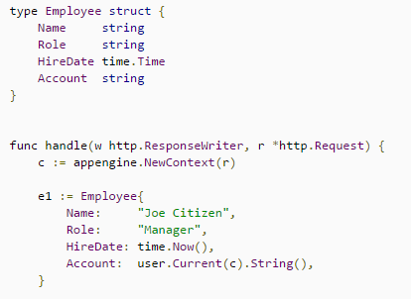
datastore
Kind: Employee
table / kind
like a type
record / entity
like a variable of a type
fields / properties
like values
Entity: e1
Properties:
Name
Role
HireDate
Account

Slide 7
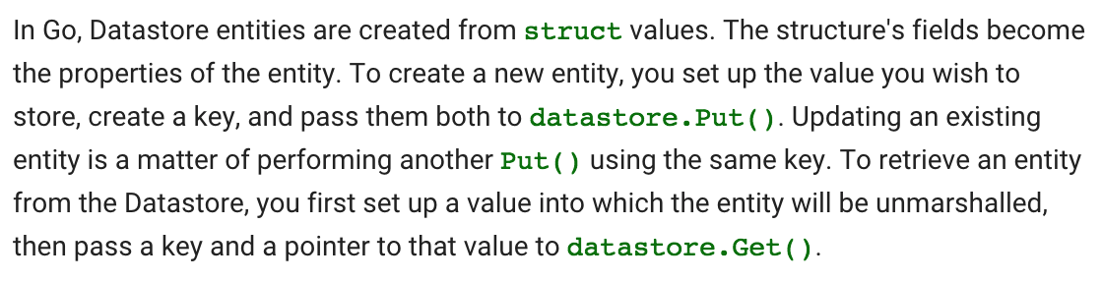
CREATE
set up the value
create a value of type struct
create a key
use datastore.Put()
pass the value & key to datastore.Put()
RETRIEVE
set up a value
create a value of type struct
use datastore.Get()
pass key & value pointer to datastore.Get()

Slide 8
datastore
Kind: Employee
kind
like a type
entity
like a variable of a type
properties
like values
Entity: e1
You can query based on properties:
eg, give me all of the employees who have the role “manager”
Properties:
Name
Role
HireDate
Account

Slide 9
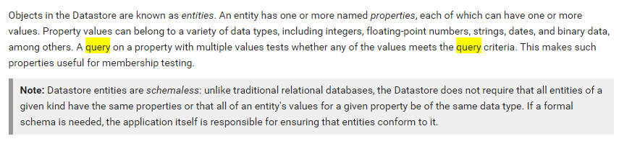

Slide 10
keys

Slide 11
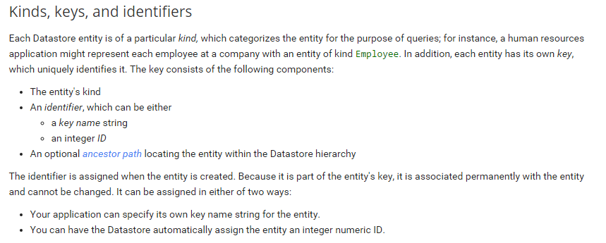

Slide 12
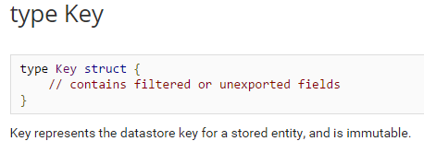
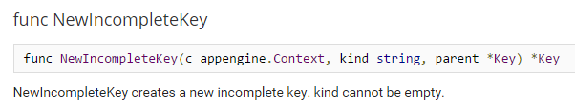
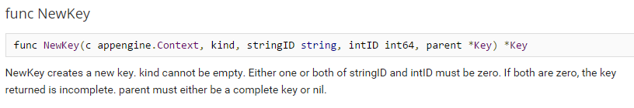
You’re letting app engine provide the unique key
You’re providing the unique key

Slide 13
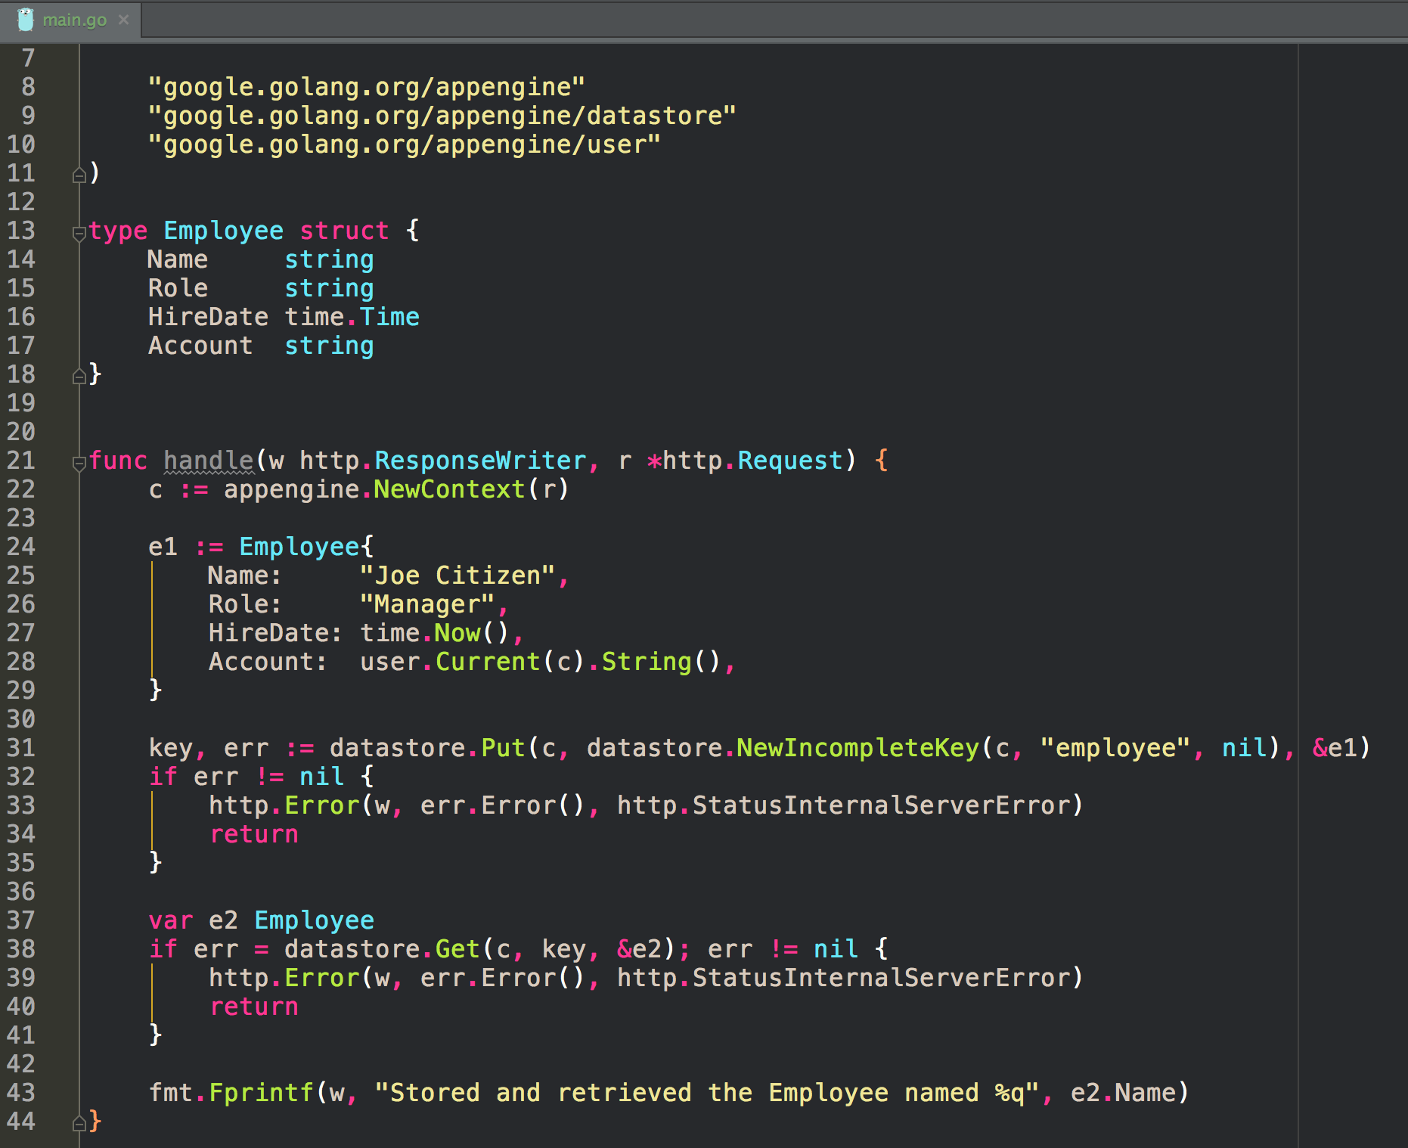

Slide 14
ancestors

Slide 15
Ancestors
There’s often a relationship between one entity and another
for example:
a user can have
post
post
post
… posts …
the ancestor of a post is the user
users have posts
users have descendents
one of their descendents might be posts
could photos be a descendent of users
Yes - users could upload photos

Slide 16
Ancestor Queries
We can query based upon ancestor
eg, give me all of the photos that have this ancestor
what I’m saying is, “give me all of the photos that belong to this user”

Slide 17
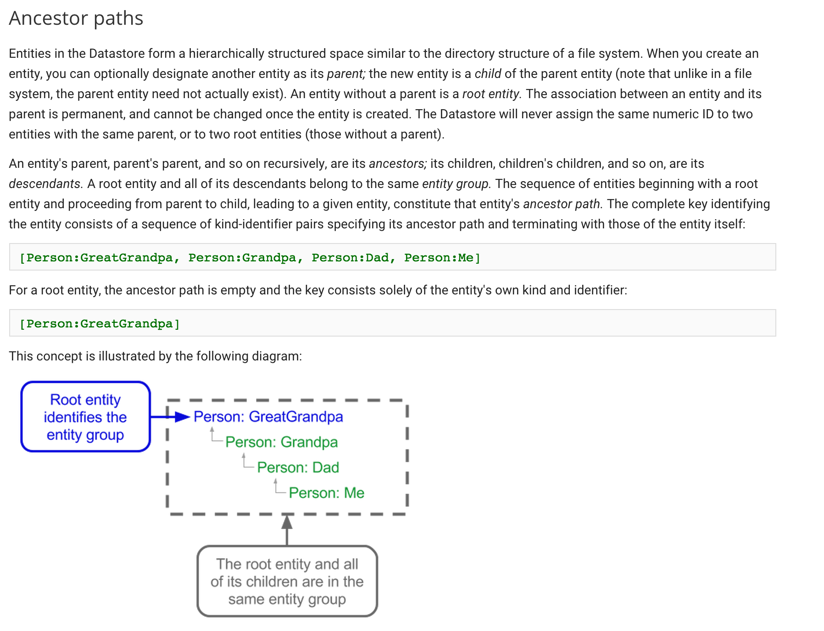

Slide 18
getting record(s)

Slide 19
Getting Records
Key
pass key & value pointer to datastore.Get()
Field query
give me all of the employees who have the role “manager”
Ancestor query
give me all of the photos that have this particular ancestor

Slide 20
Getting Records
Key
pass key & value pointer to datastore.Get()
Field query
give me all of the employees who have the role “manager”
Ancestor query
give me all of the photos that have this particular ancestor
The query operates on entities of a given kind

Slide 21
Getting Records
The fields (properties) are indexed
Key
pass key & value pointer to datastore.Get()
Field query
give me all of the employees who have the role “manager”
Ancestor query
give me all of the photos that have this particular ancestor
The query operates on entities of a given kind

Slide 22
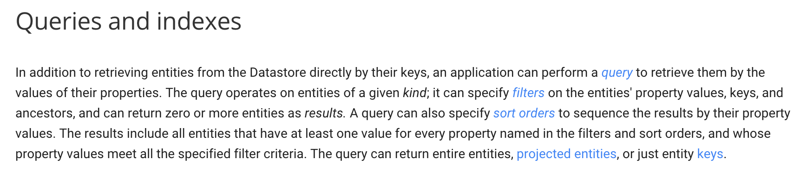

Slide 24
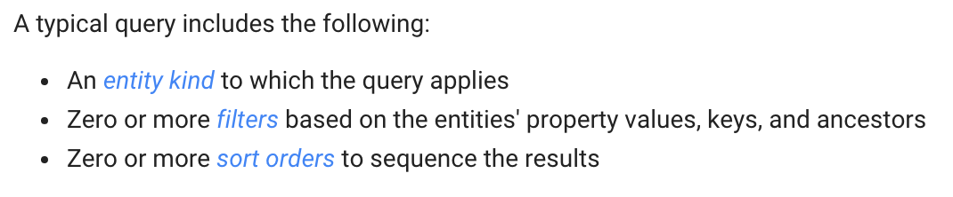

Slide 25
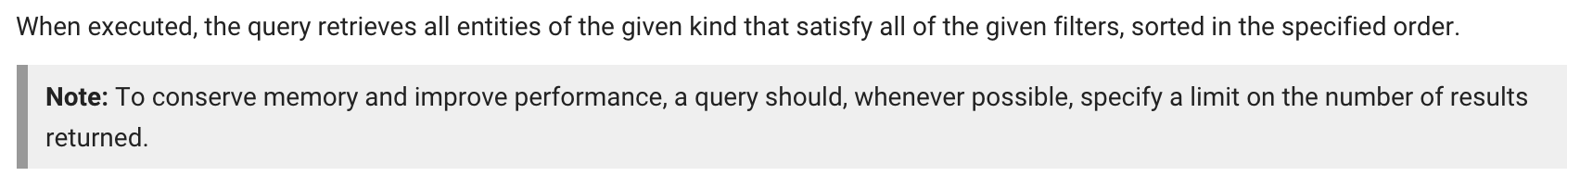

Slide 26
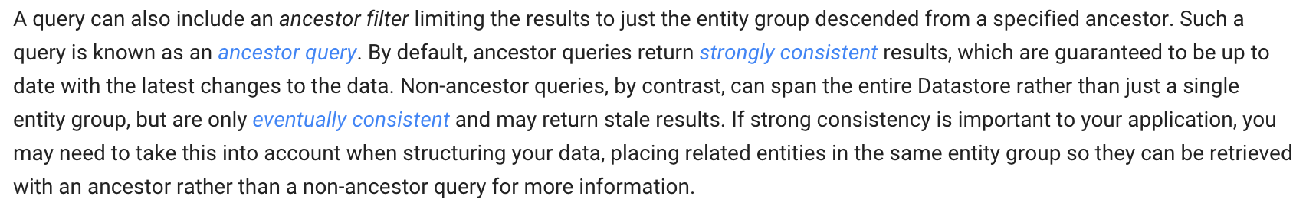

Slide 27
believe the bird, not the book

Slide 28
put

Slide 29
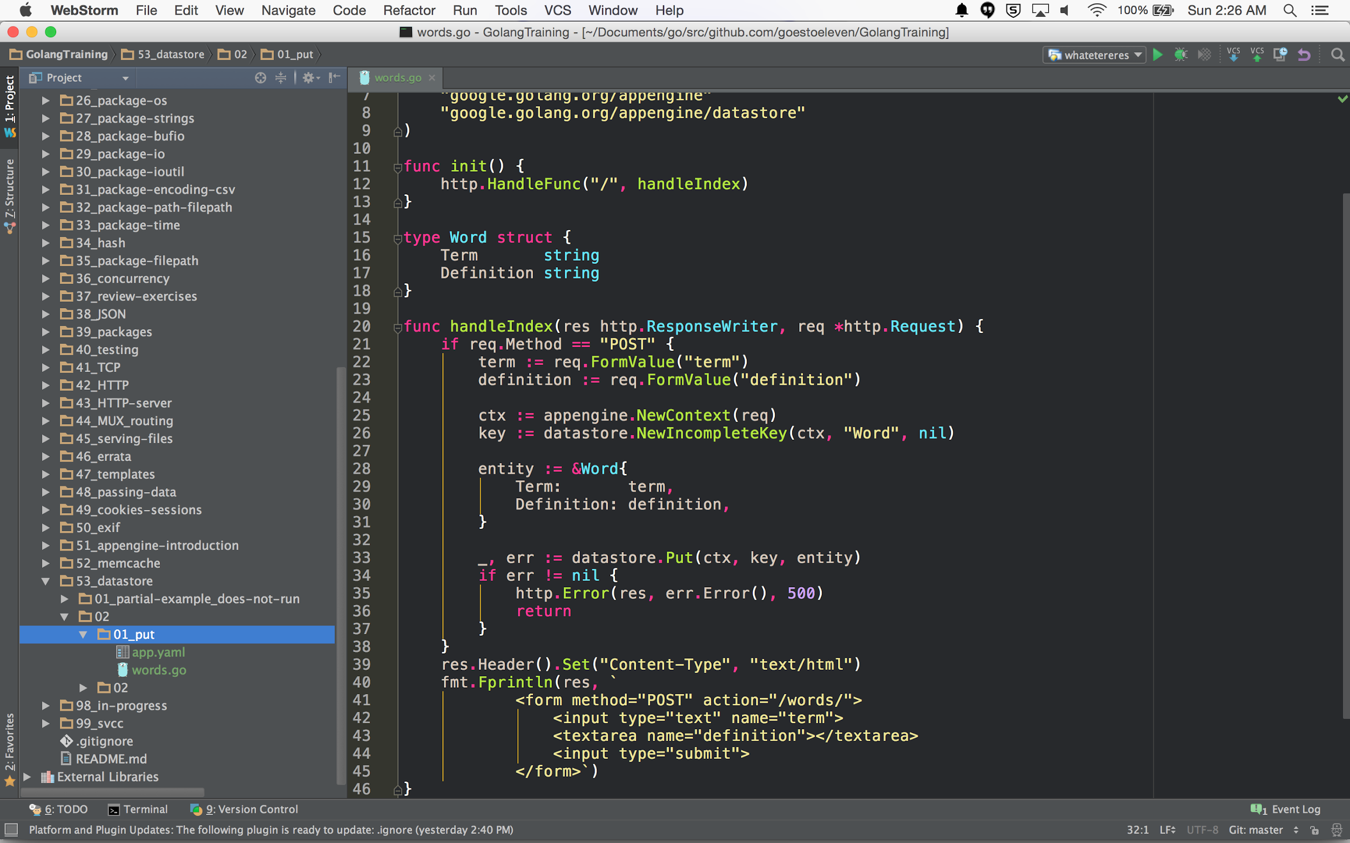

Slide 30
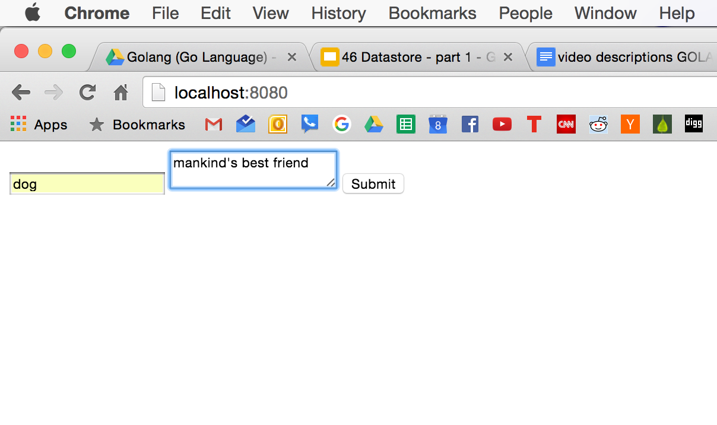

Slide 31
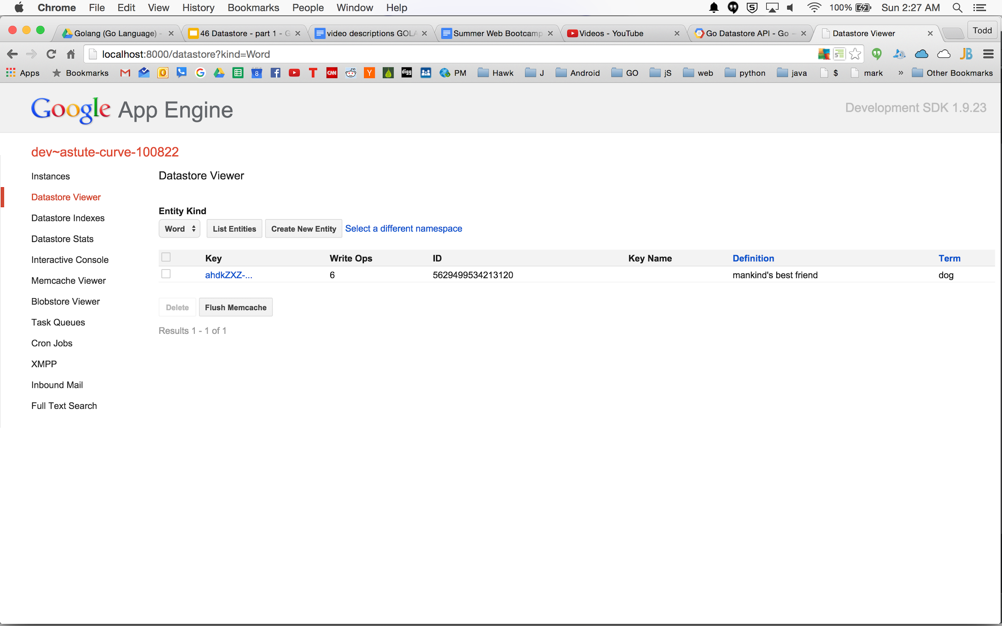

Slide 32
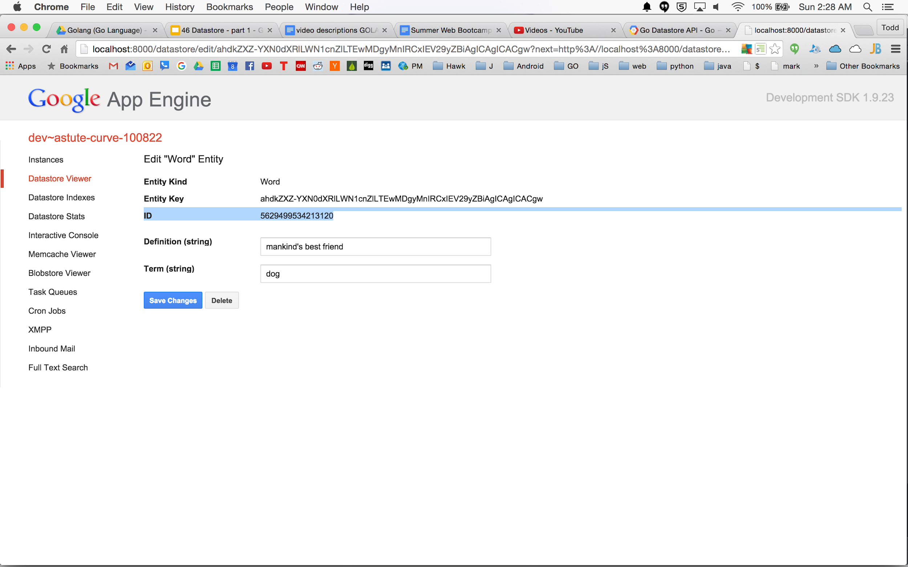

Slide 33
put

Slide 34
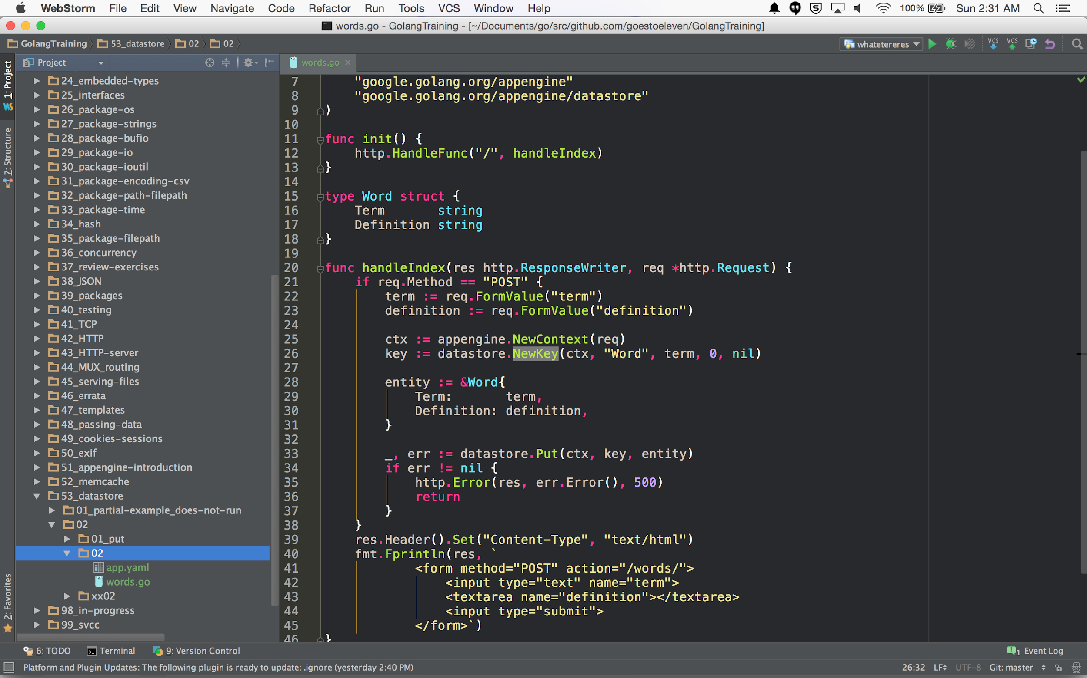

Slide 35
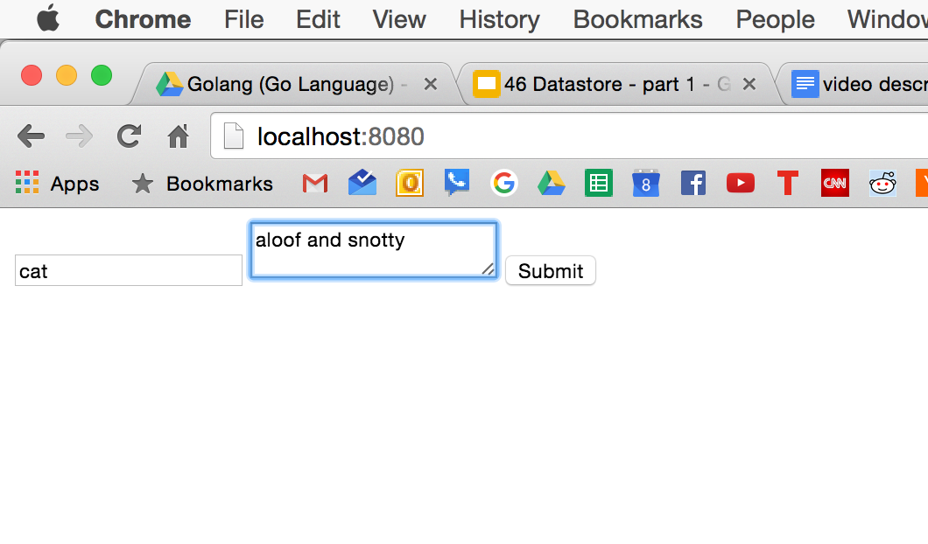

Slide 36
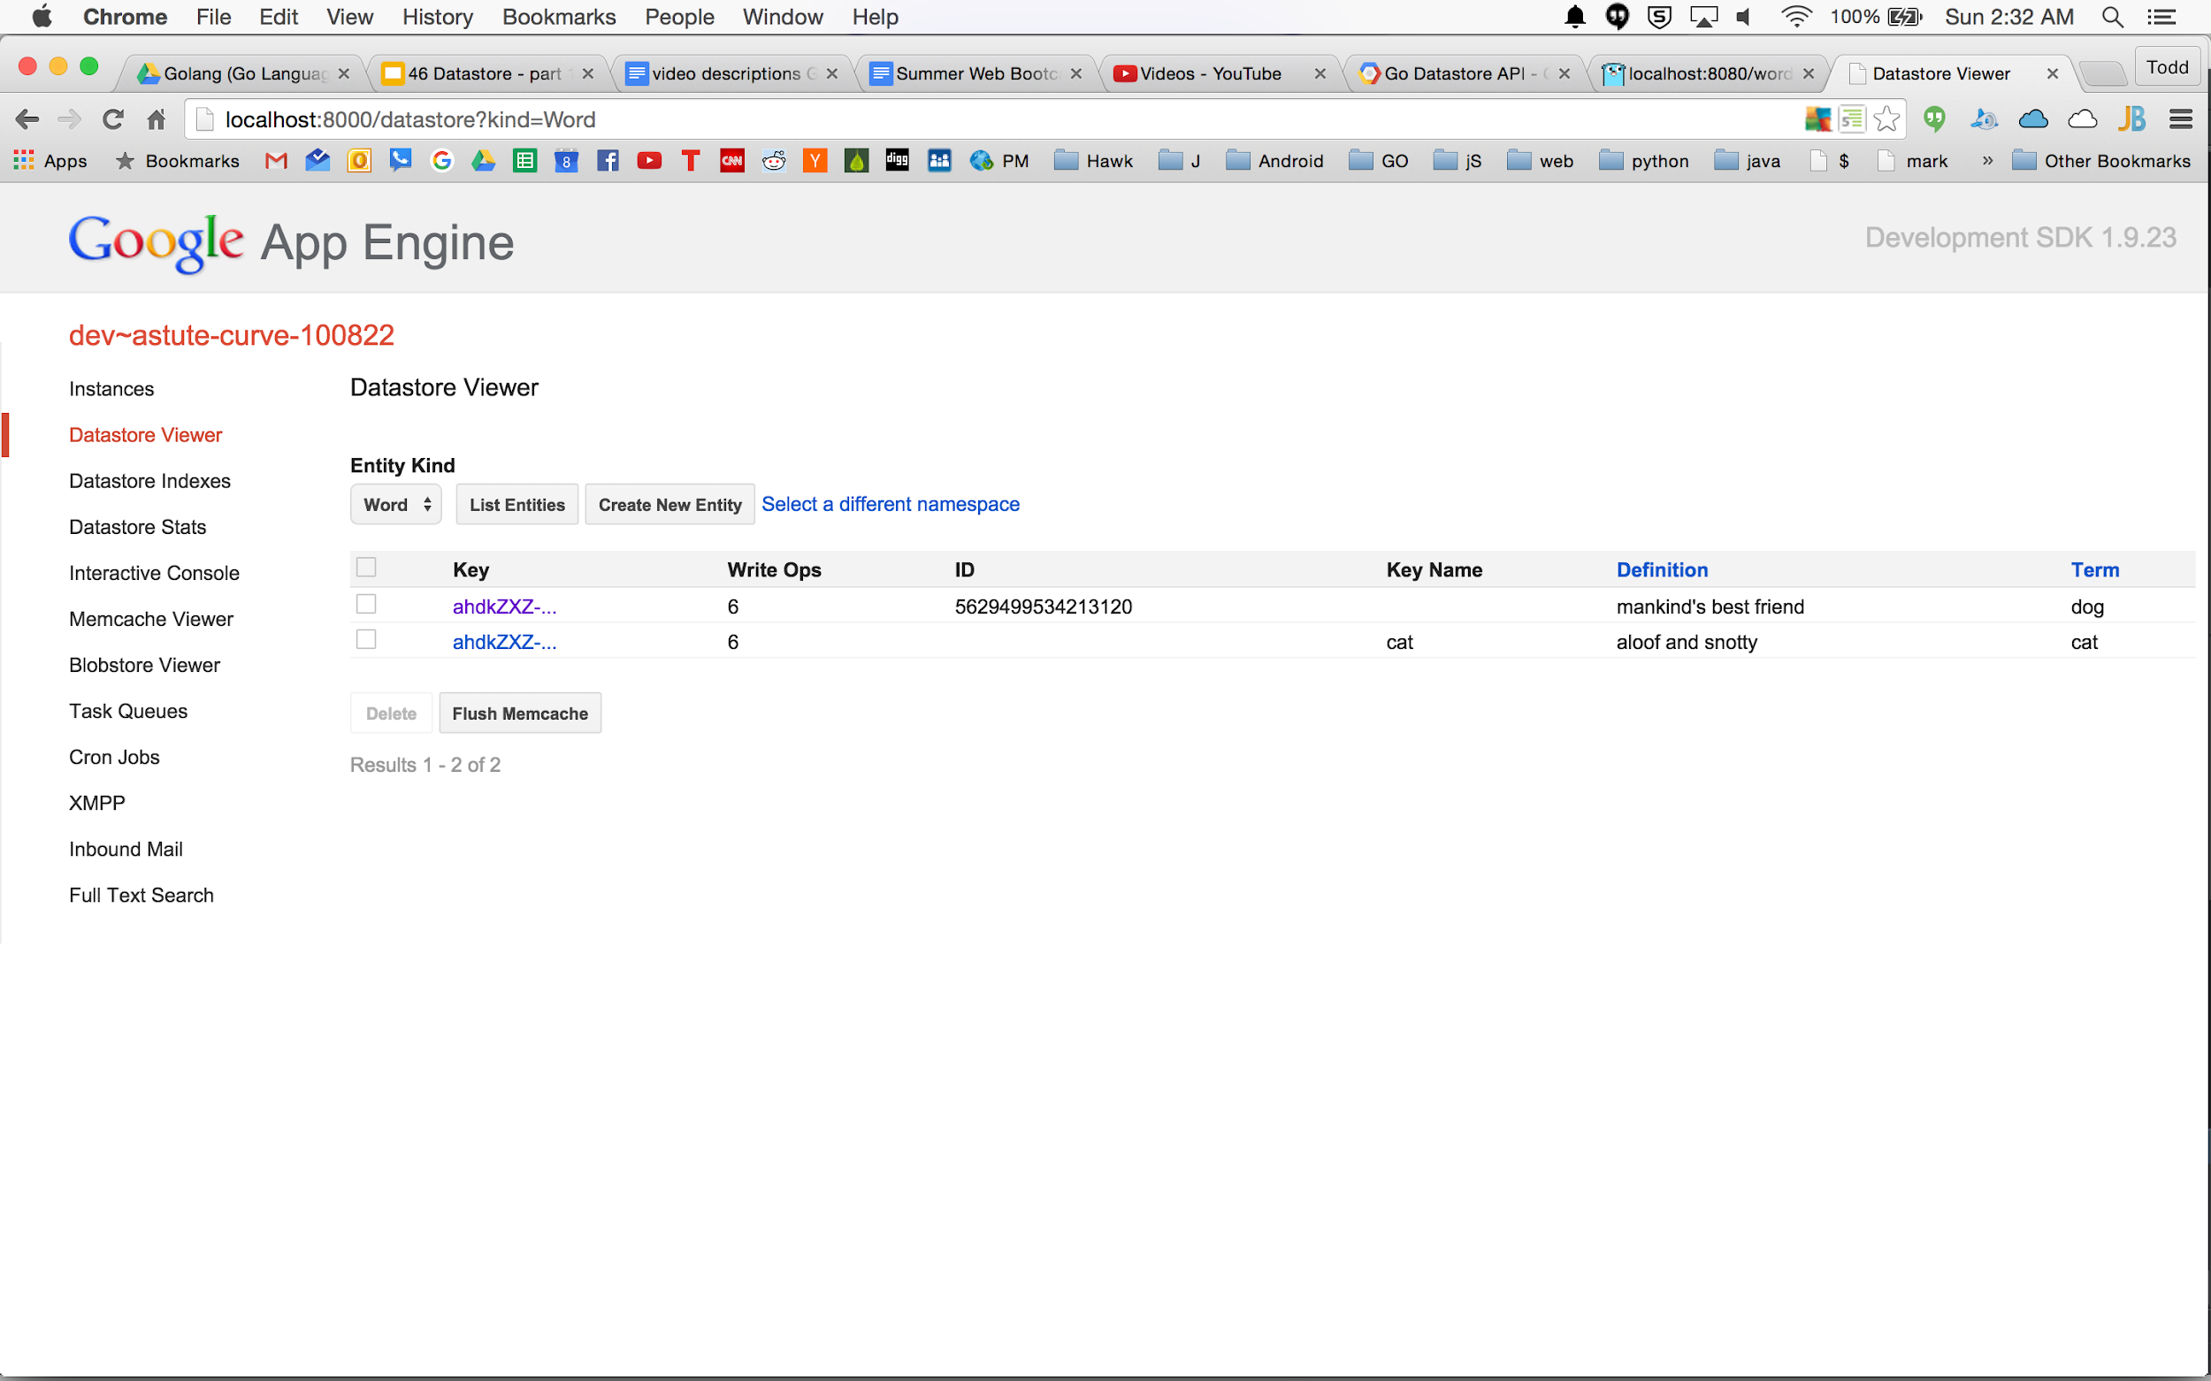

Slide 37
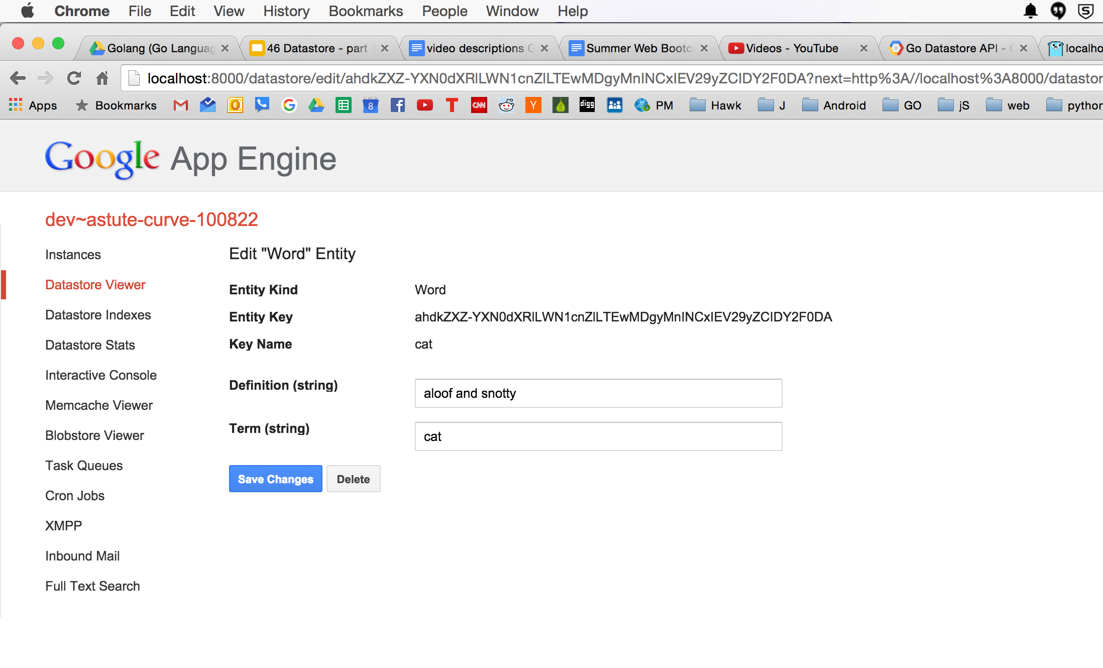

Slide 38
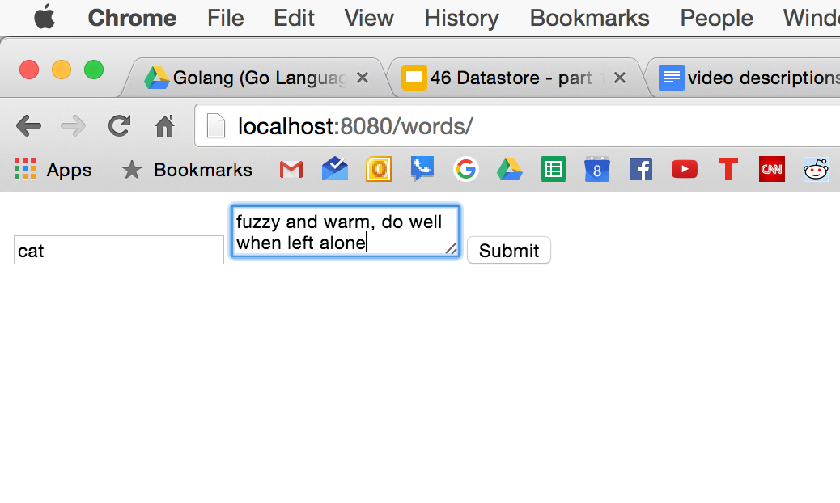

Slide 39
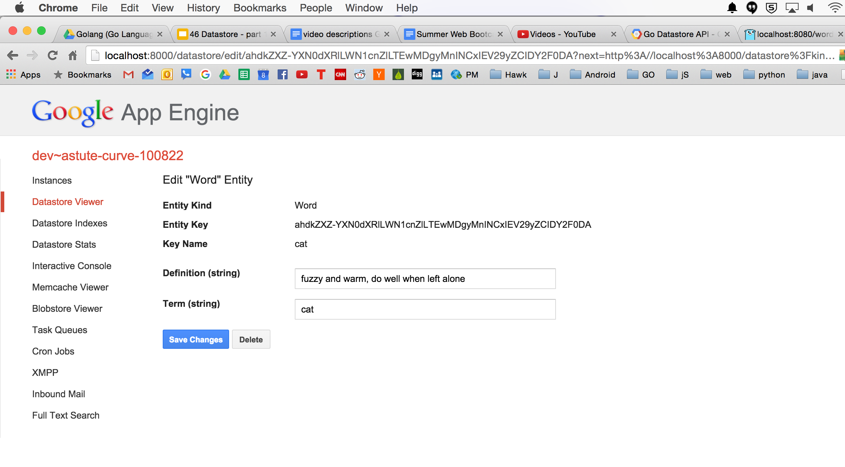

Slide 40
Use NewKey when a unique key is obvious
ie, email as the key for a user
NewIncompleteKey
ie, random int ID for photos

Slide 41
getting records

Slide 42
Getting Records
The fields (properties) are indexed
Key
pass key & value pointer to datastore.Get()
Field query
give me all of the employees who have the role “manager”
Ancestor query
give me all of the photos that have this particular ancestor
The query operates on entities of a given kind

Slide 43
get
key

Slide 44
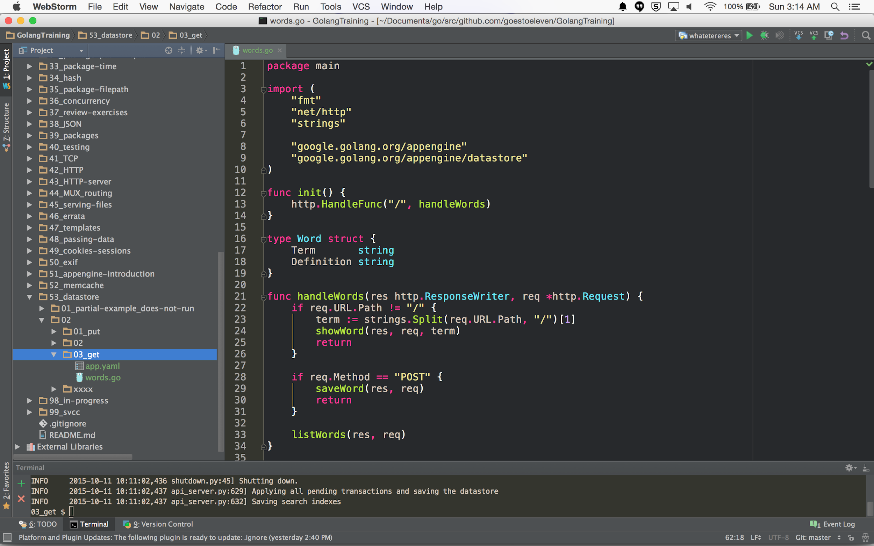

Slide 45
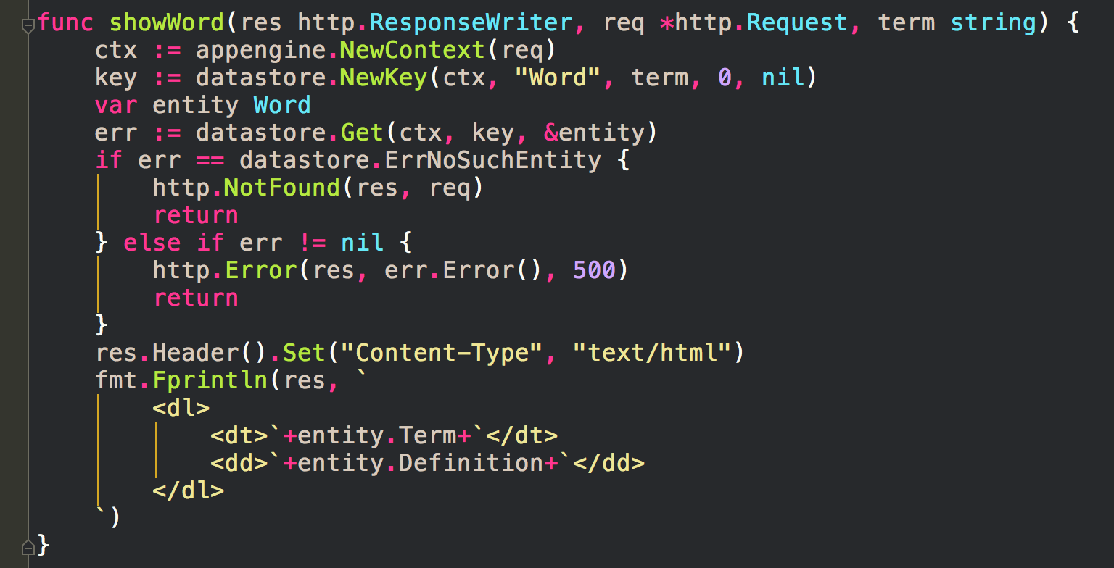

Slide 46
NewQuery
kind query

Slide 47
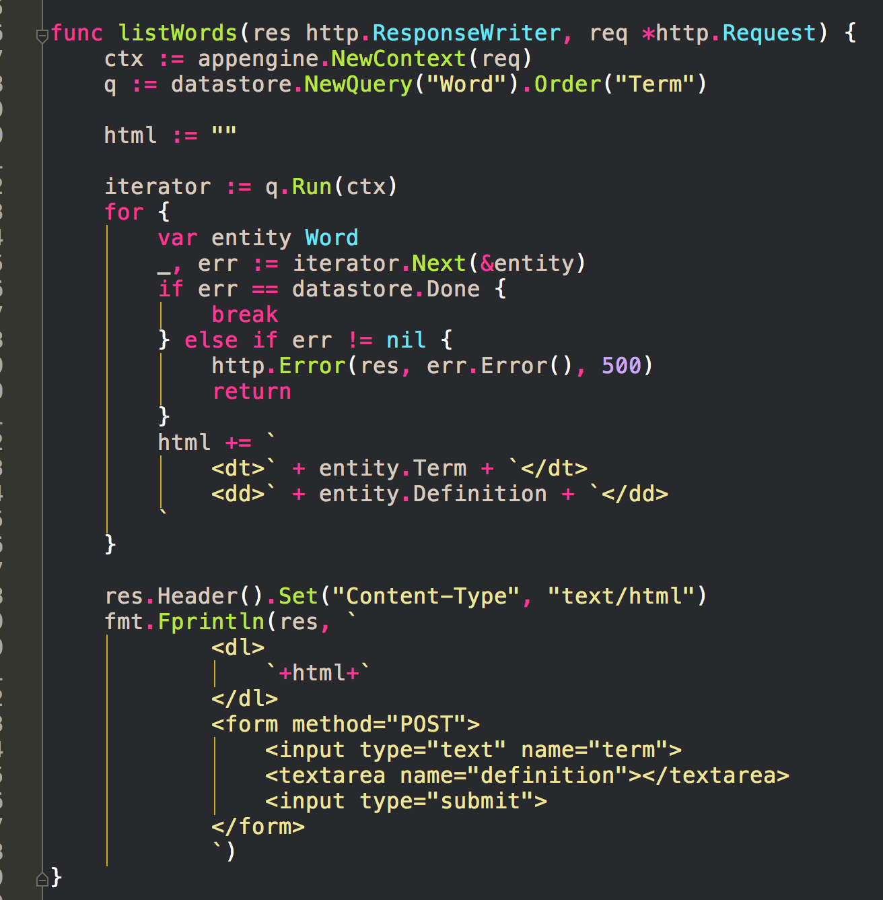

Slide 48
put
(review)

Slide 49
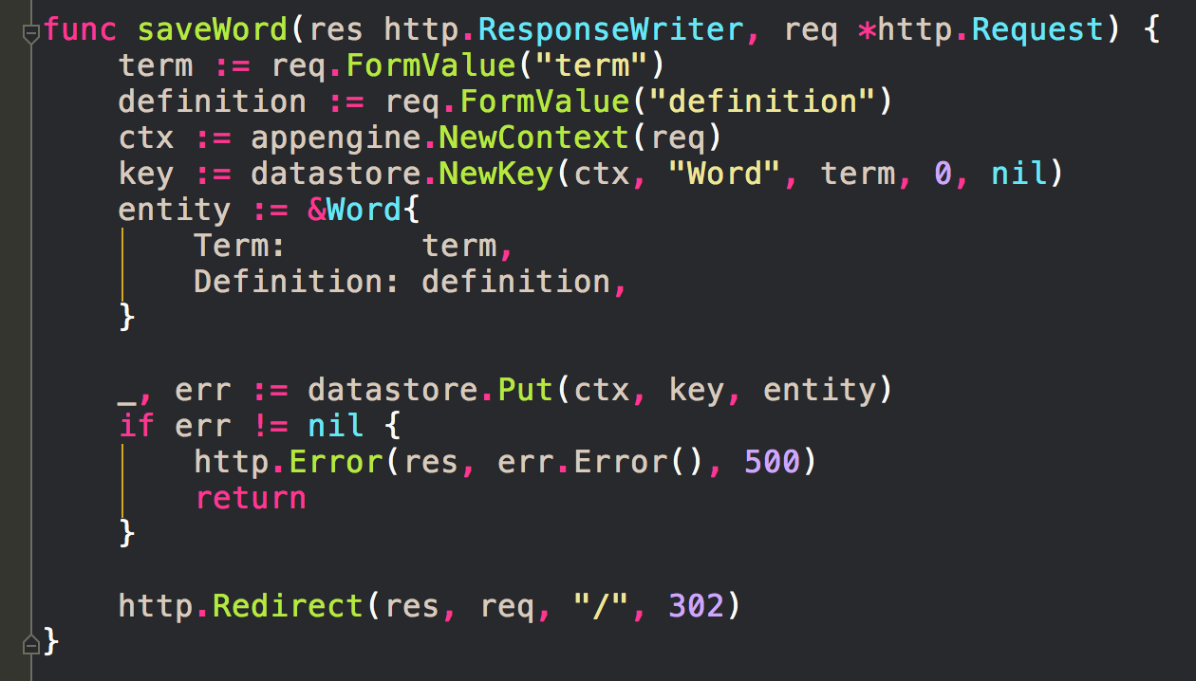

Slide 50
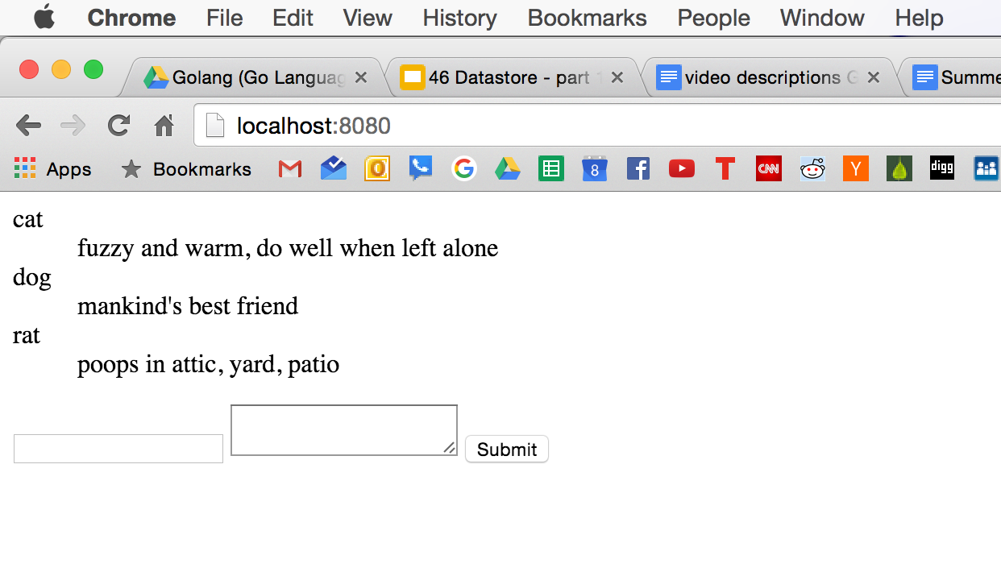

Slide 51
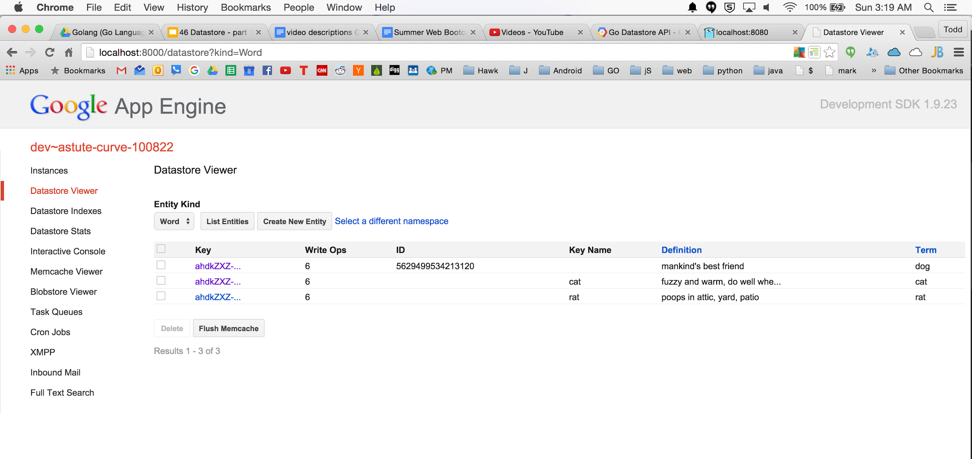

Slide 52
NewQuery
field filter

Slide 53
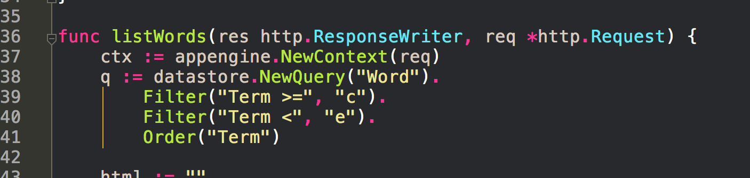

Slide 54
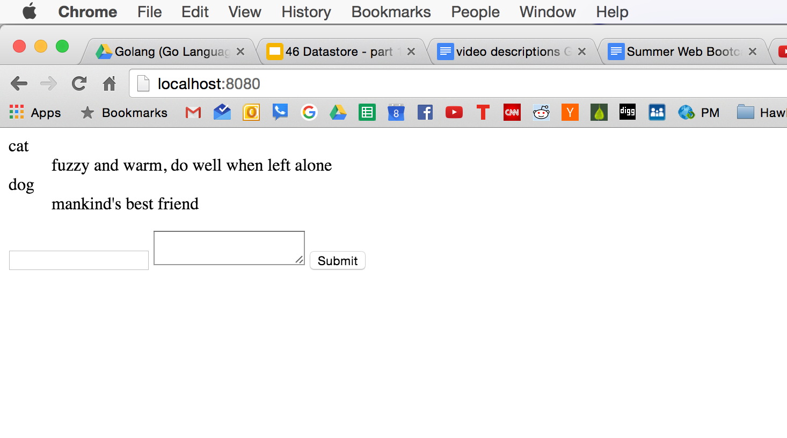

Slide 56
docs

Slide 57
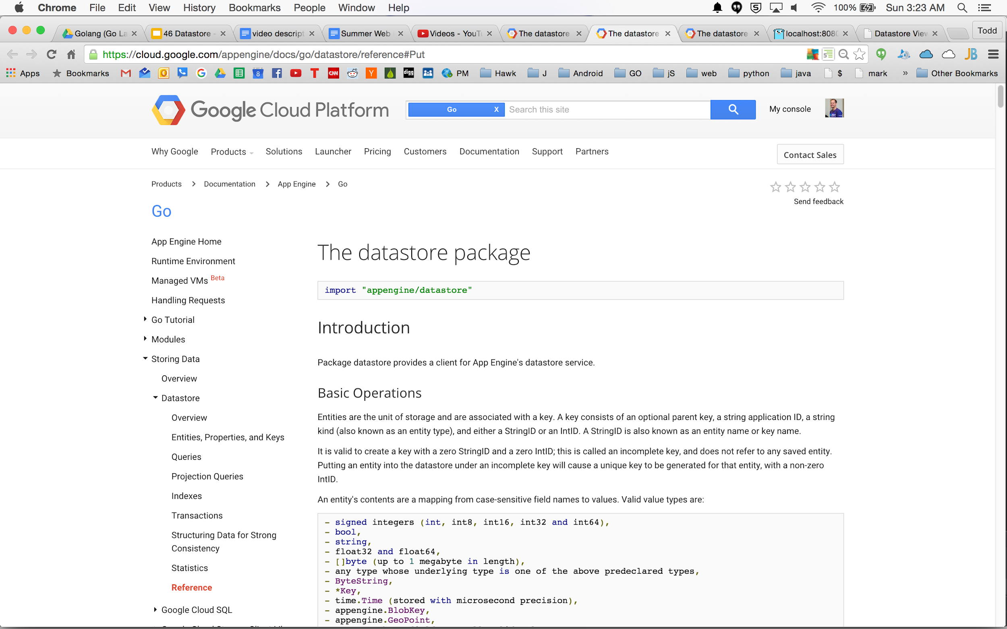

Slide 58
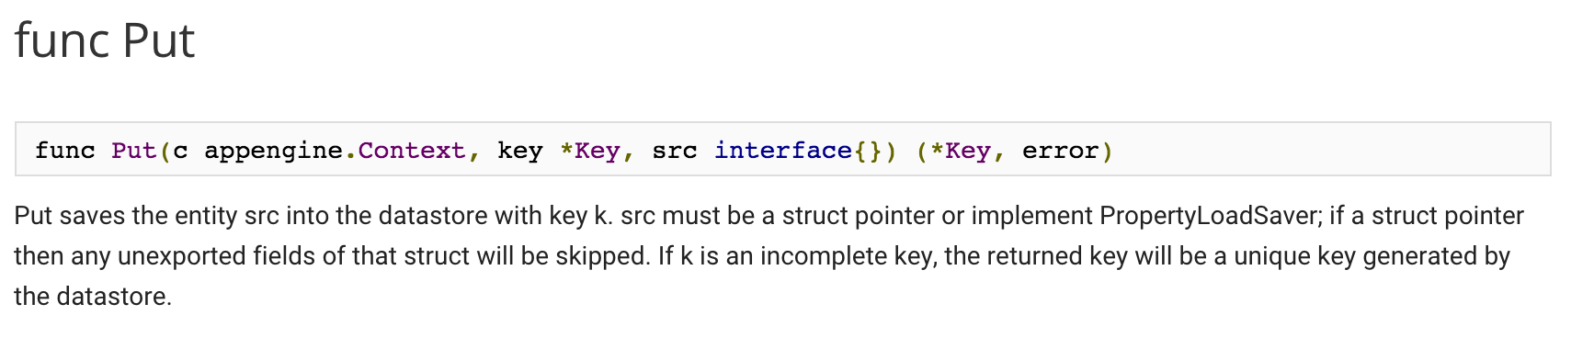

Slide 59
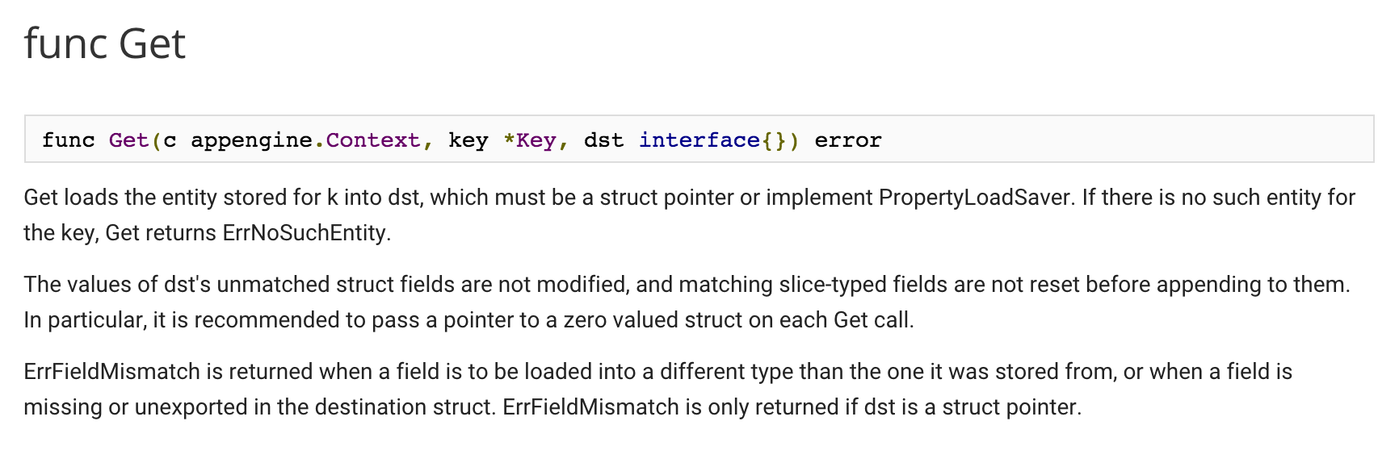

Slide 60
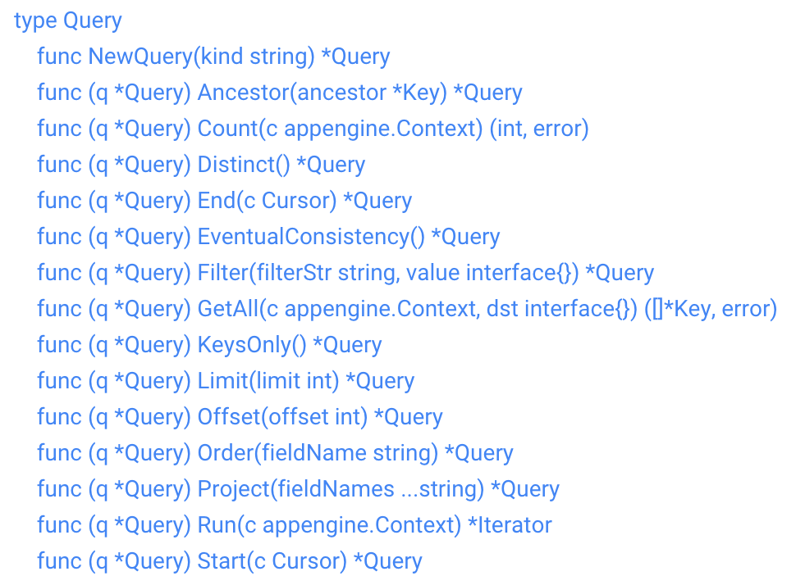

Slide 61
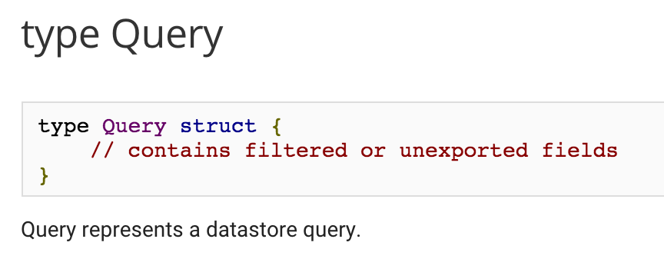

Slide 62
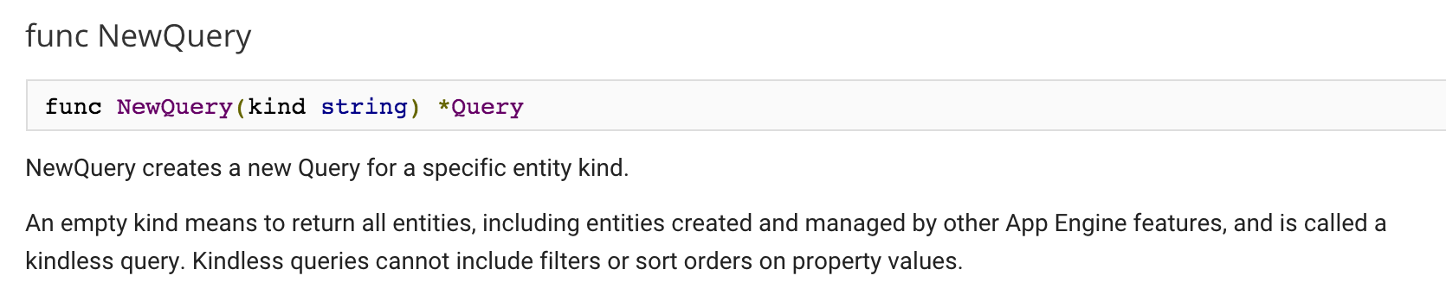
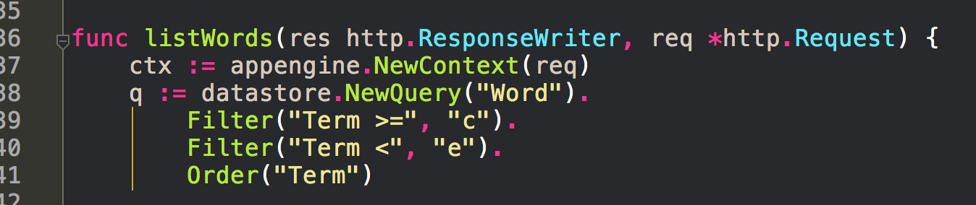

Slide 63
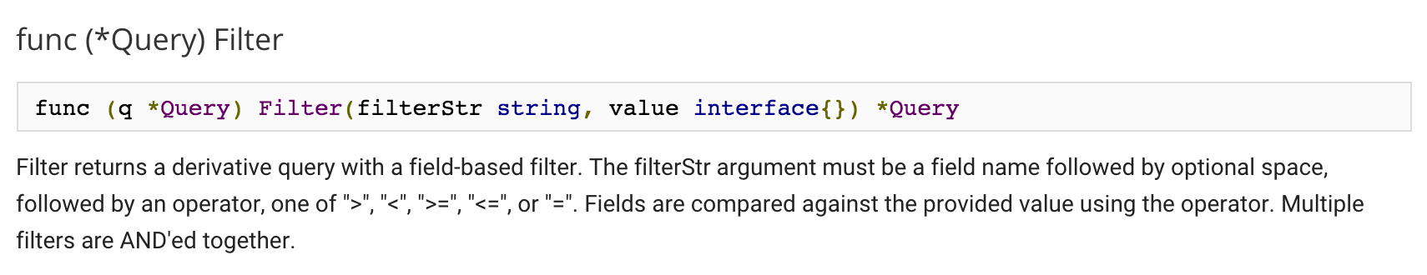

Slide 64
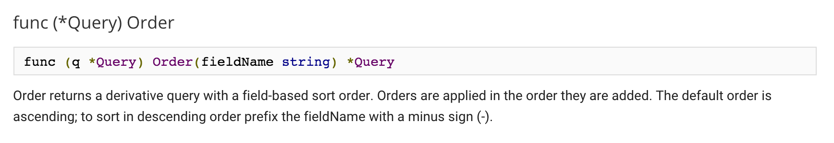

Slide 65
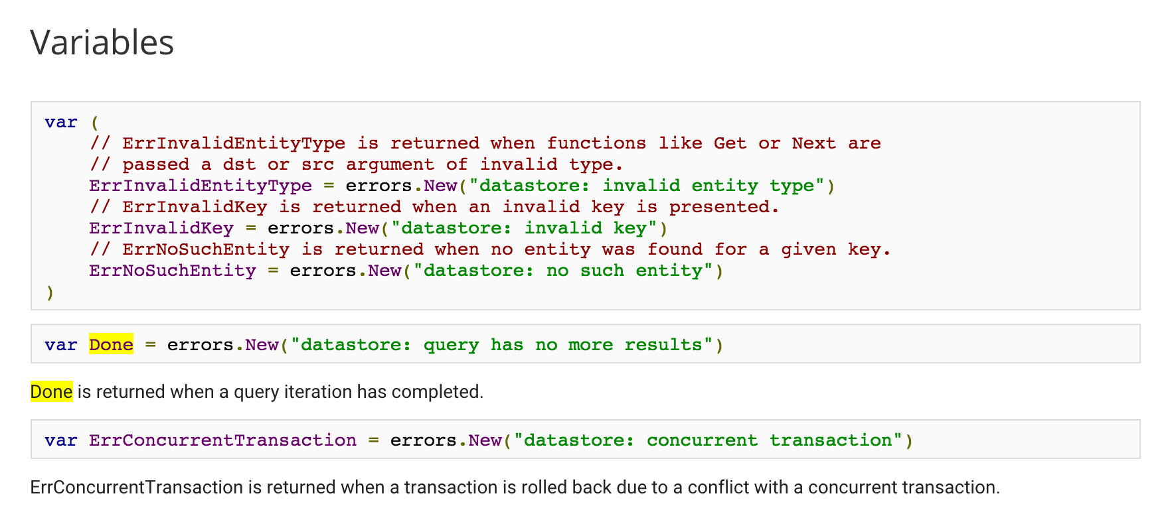
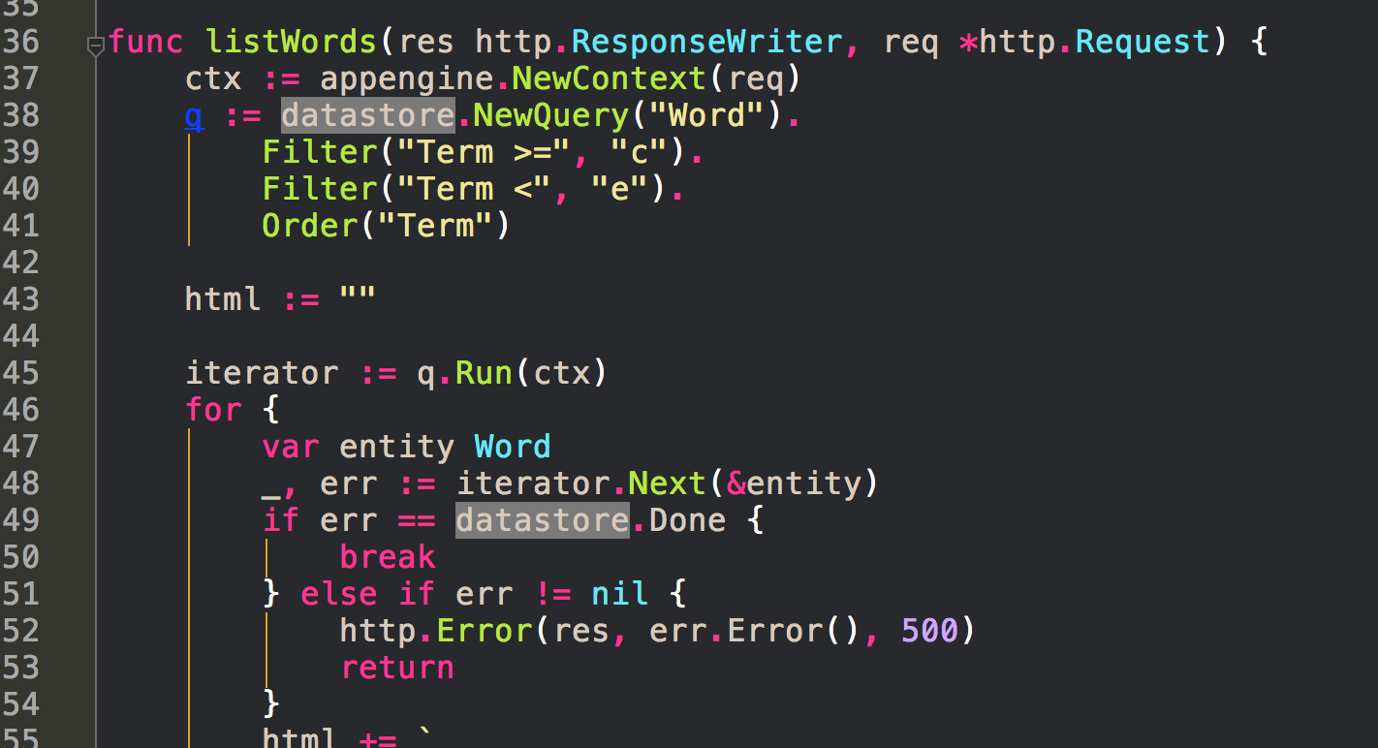

Slide 66
exercise

Slide 67
Datastore
Create a user profile page that requires login (via Google) and save profile information in the data store.

Slide 68
exercise solution

Slide 69
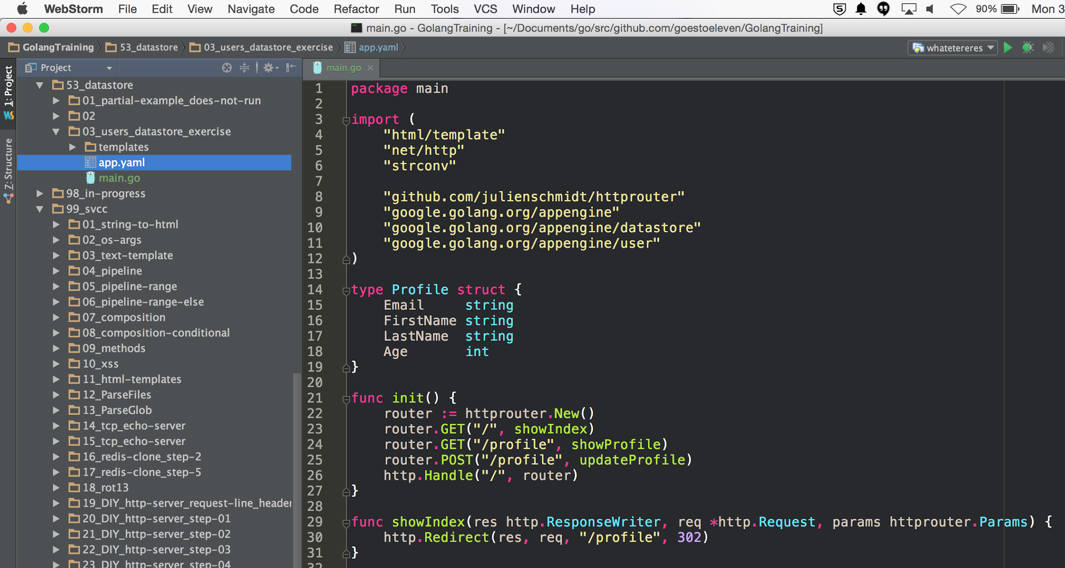

Slide 70
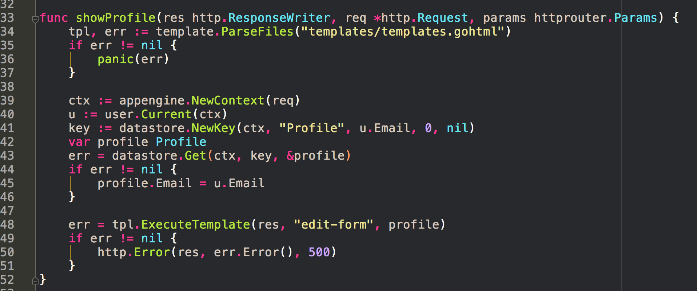

Slide 71
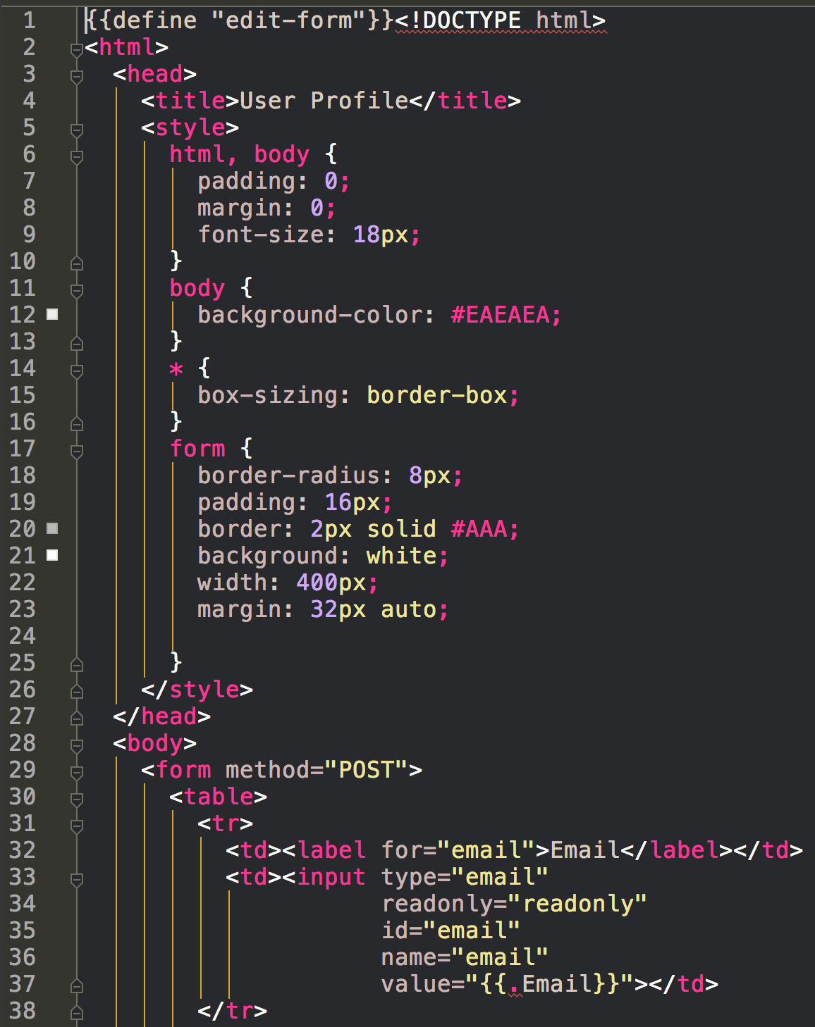
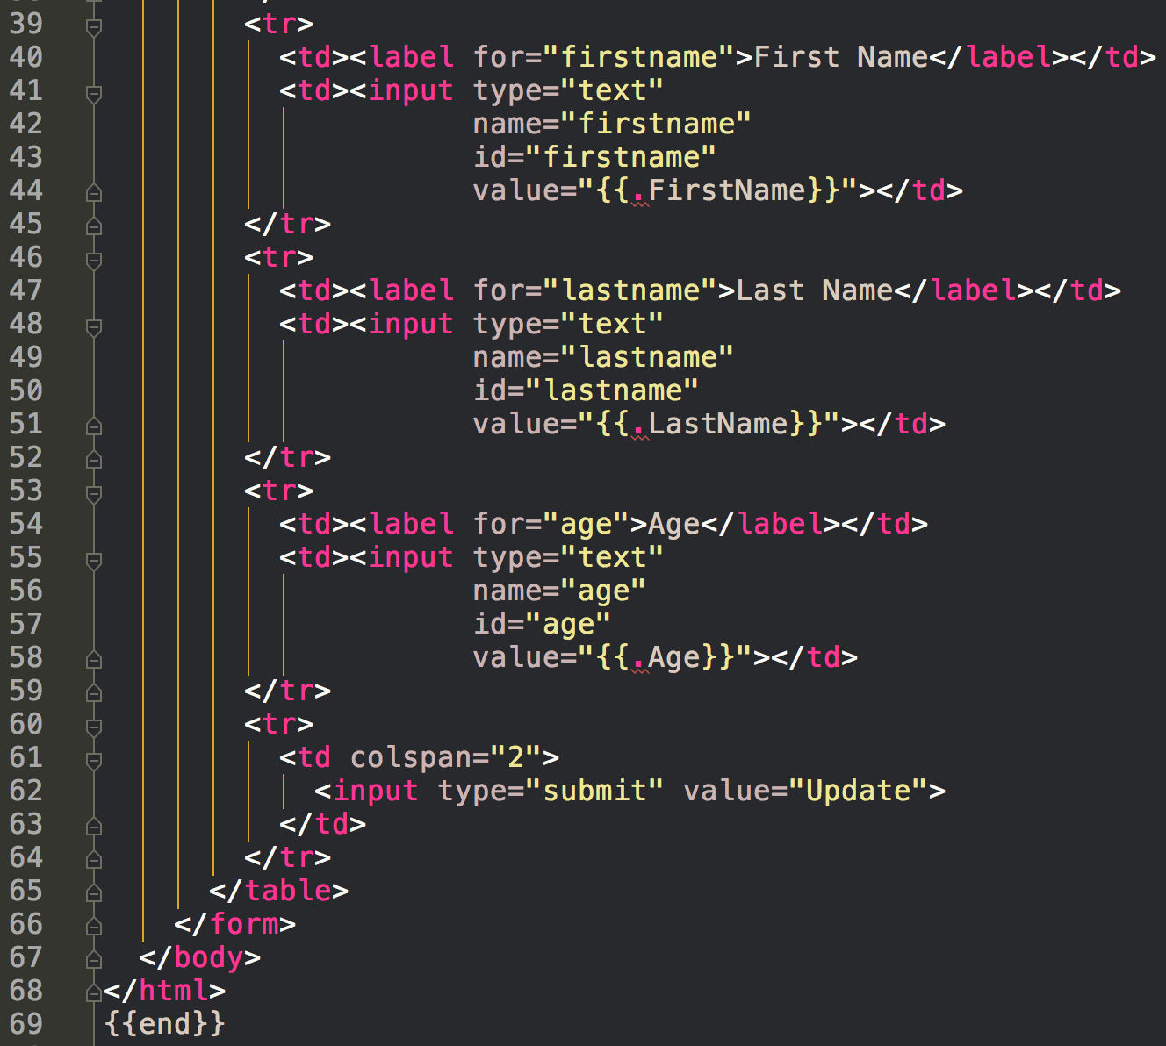

Slide 72
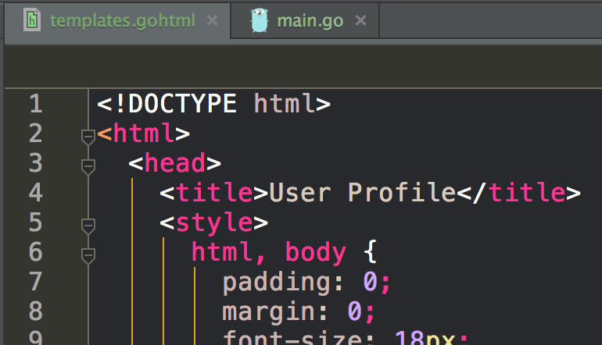
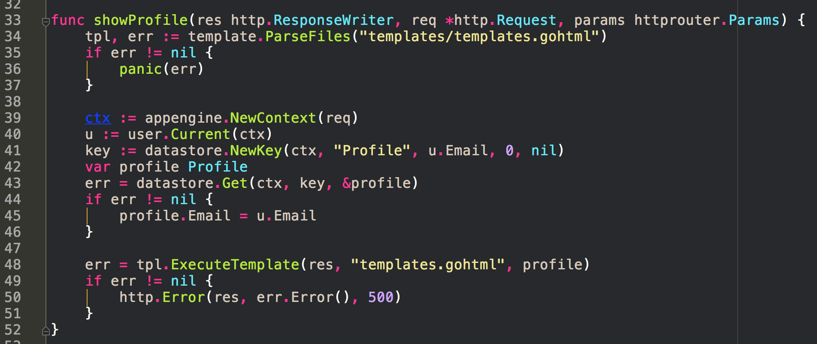
You could also do it like this
no {{define "edit-form"}}

Slide 73
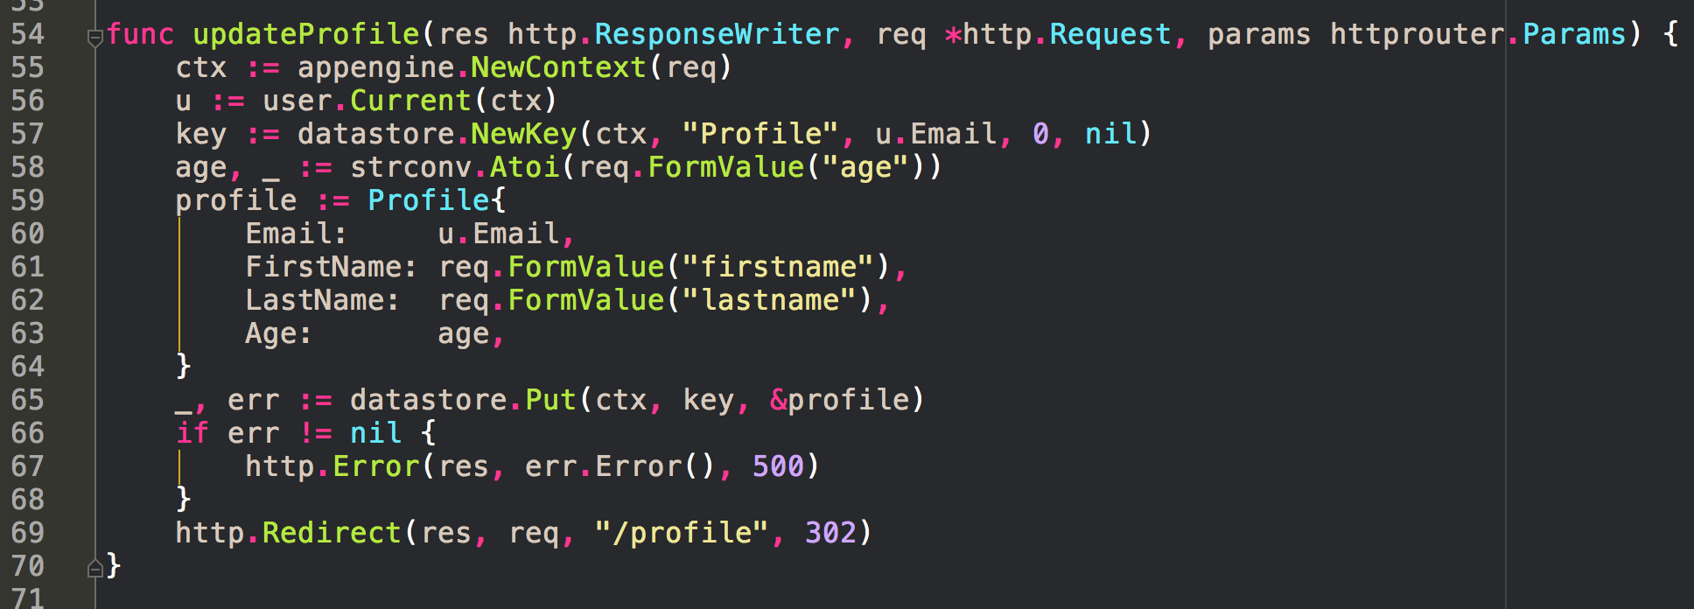

Slide 74
julien schmidt router

Slide 75
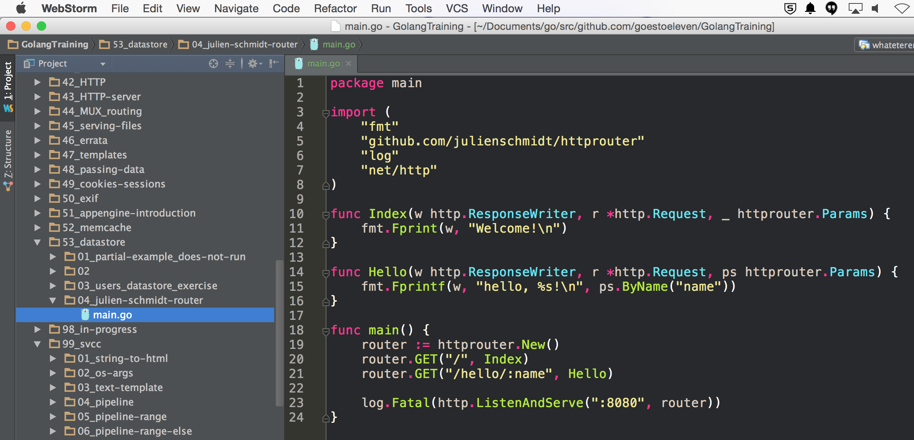

Slide 76


Slide 77


Slide 78
extra reading
(not for in-class lecture)

Slide 79
tutorial
https://cloud.google.com/go/

Slide 80
nosql

Slide 81


Slide 82


Slide 83


